Slide 1


Capstone Project - 01
Global Terrorism Analysis
Project Type - EDA
Contribution – Individual
Presented By – Throat Ajit Dattu

Slide 2
Table of contents
1. Introduction.
2. Problem Statement.
3. Dataset Preparation.
4. Data Summary.
5. Analysis and visualization of data.
5.1 analysis based on number of attacks per year.
5.2 analysis based on number of people killed per year.
5.3 analysis based on most affected area of terrorism.
5.3.1 based on region.
5.3.2 based on country.
5.4 analysis based on terrorist organization.
5.4.1 based on most active terrorist organization who attacks the most.
5.4.2 based on most dangerous terrorist organization who killed the most number of people.
5.4.3 based on most used weapon by terrorist organization.
5.5 Country wise analysis.
5.5.1 Country Iraq.
5.5.2 Country India.
6. Challenge Faced.
7. Conclusion.

Slide 3

Introduction
Definition of Terrorism :-
"The calculated use of unlawful violence or threat of unlawful violence to inculcate fear; intended to coerce or to intimidate governments or societies in the pursuit of goals that are generally political, religious, or ideological"
• The objective is to perform Exploratory Data Analysis on global terrorism dataset to find out the hot zone of terrorism
• Exploratory data analysis is nothing but analyzing the given data and finding the trends, Patterns and insights.

Slide 4

Problem statement
The Global Terrorism Database (GTD) is an open-source database including information on terrorist attacks around the world from 1970 through 2017.
The GTD includes systematic data on domestic as well as international terrorist incidents that have occurred during this time period and now includes more than 180,000 attacks. The database is maintained by researchers at the National Consortium for the Study of Terrorism and Responses to Terrorism (START), headquartered at the University of Maryland.
Explore and analyze the data to discover key findings pertaining to terrorist activities

Slide 5
Dataset Preparation
Loading the dataset: Load the Global Terrorism Dataset by mounting the drive.
Import Libraries: NumPy, Pandas, Seaborn and Matplotlib
Data cleaning: Finding null values, Replacing the null value with zero, Finding duplicate values, Creating the copy of main dataset etc.
Exploratory Data Analysis: Analyzing the data sets to summarize their main characteristics using statistical graphics and data visualizations method.

Slide 6
Data summary
Year | Year of Terrorist Attack
Month | Month of Terrorist Attack
Day | On which Day Terrorist Attack is happened
Latitude | Y Co-ordinates of Terrorist Attack point
Longitude | X Co-ordinate of Terrorist Attack point
Region | Region of Terrorist Attack
Country | Country of Terrorist Attack
State | State of Terrorist Attack
city | City in which terrorist attack happen

Slide 7
Attack_Type | Type of Terrorist Attack
Killed | Number of people killed in the Terrorist Attack
Gang_Name | Name of Terrorist Organization
Wounded | Number of people Injured in the Terrorist Attack
Main_Target | Main target of the Terrorist Attack
Sub_Target | Sub target of Terrorist Attack
Weapon_type | Weapon used in the Terrorist Attack
Motive | Motive of Terrorist Attack
Nationality | Nationality of Terrorist Organization
Casualties | It is the Sum of Number of people killed and Number of people Injured in the Terrorist Attack

Slide 8
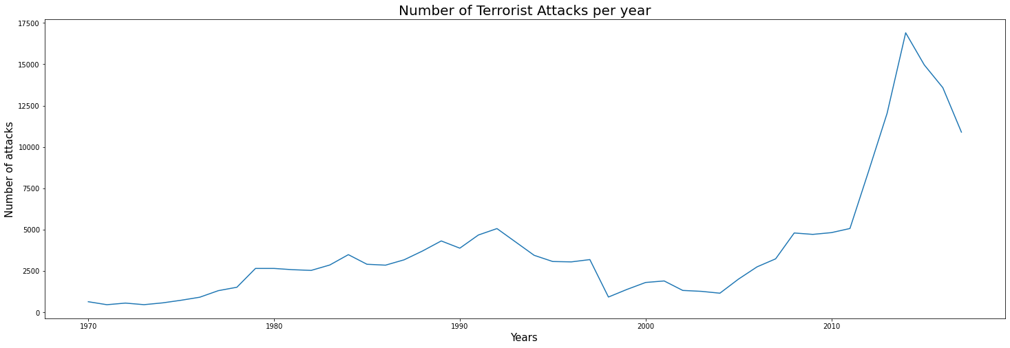
Analysis and visualization of data
1.Yearly growth of terrorist attacks
Observation :-
1.From the above graph we can say that After 2004 there is a large growth recorded in terrorist attack.
2.Maximum Number of the attacks were recorded in year 2014
3.Minimum number of attacks were recorded in the year 1971

Slide 9
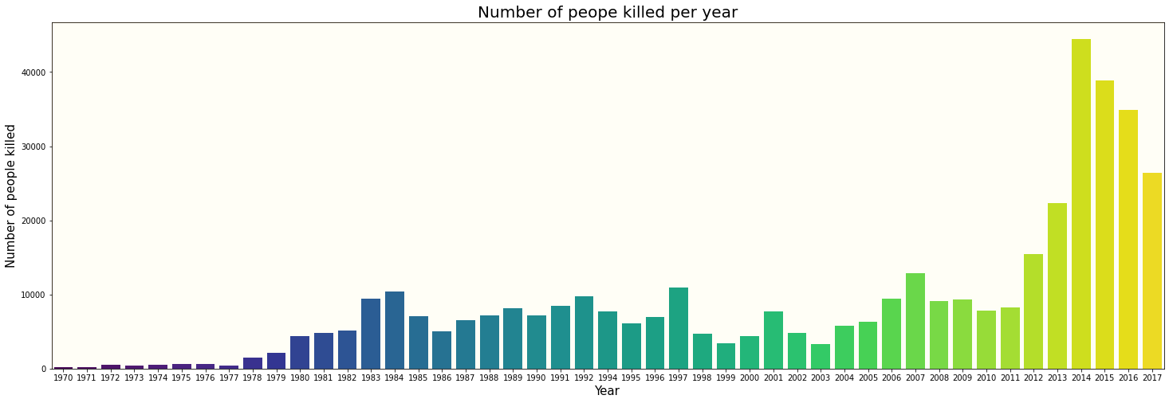
2.Number of people killed Due to Terrorism per year
Observation:-
1.Due to increase in terrorism activity after 2004 ,number of people killed per year is also increases.
2.Most Number of People killed in year 2014.
3.Minimum Number of People killed in year 1971.

Slide 10
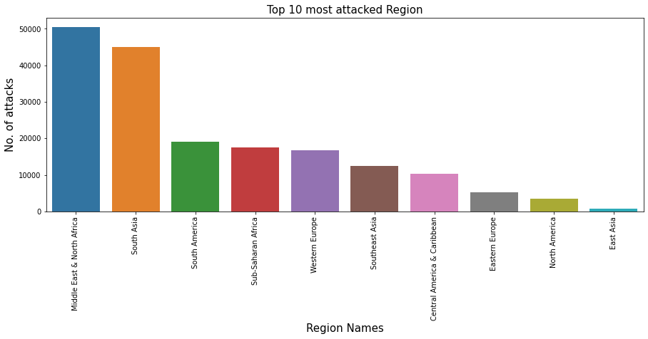
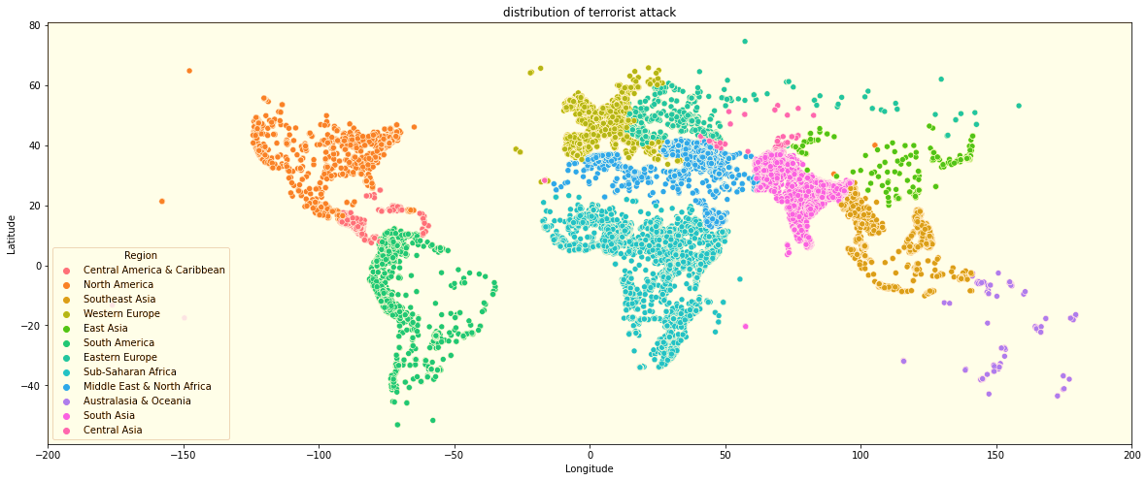
3.Analysis based on Most affected area of Terrorism
3.1Top 10 Most affected Region
Observation:-
1.From the scatter and bar plot we can say that Middle East and North America is the most affected region of Terrorist Attack.
2.Australasia & Oceania is the most safest region because there is less number of Terrorism compare to other region.

Slide 11
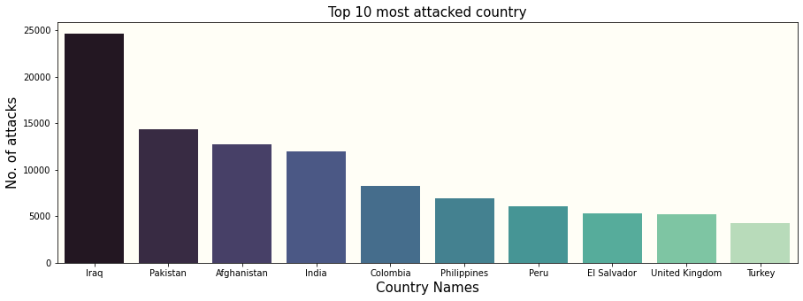
3.2Top 10 Most affected Country
Observation:-
1.Iraq is the most affected country of terrorism which records highest number of terrorism activity in any country.
2.India ranked number 4 in terms of most affected country of the terrorist activity

Slide 12
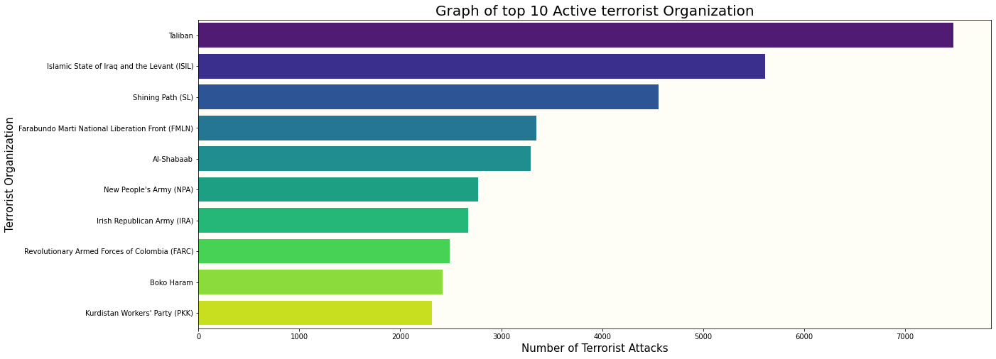
4.Analysis based on Terrorist Organization
4.1Top 10 Active Terrorist Organizations who attack the most
Observation:-
Taliban and Islamic State of Iraq and the Levant (ISIL) are the Most active terrorist Organization who attack the most around the world.
Taliban recorded most number of attacks

Slide 13
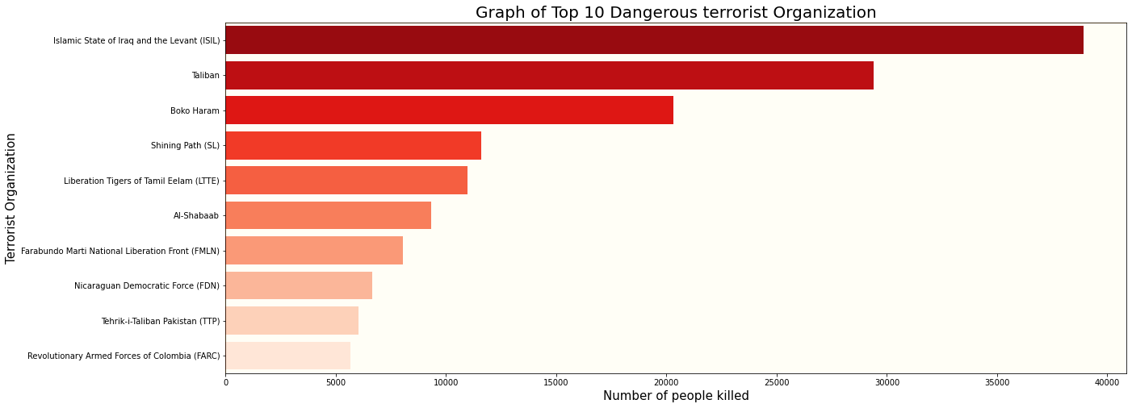
4.2Top 10 Dangerous Terrorist Organization who killed the most number of people
Observation:-
1.Islamic State of Iraq and the Levant (ISIL) and Taliban is the most dangerous Terrorist Organization in the world which records highest kills 38923.0 and 29410.0 respectively
2.Out of all the top 10 Organizations, around 46% people killed by ISIL and Taliban organization.

Slide 14
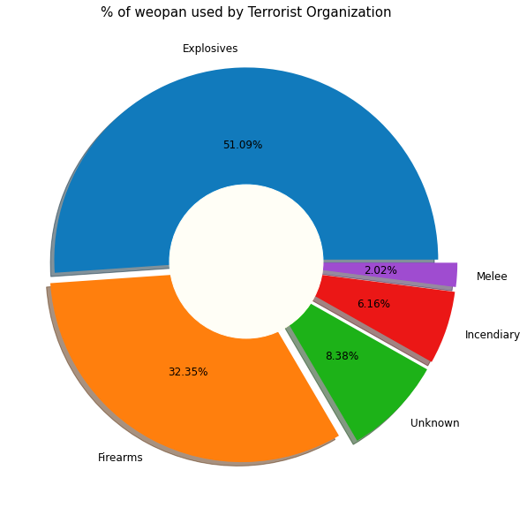
4.3Top 5 Most use weapon by Terrorist Organization
1.To get the Percentage of Weapon
used by Terrorist Organization we use
Pie Chart
2.It seen that explosives were used in
around 51.09 % of the attacks, followed
by Firearms accounted for 32.35% of
the attacks.

Slide 15
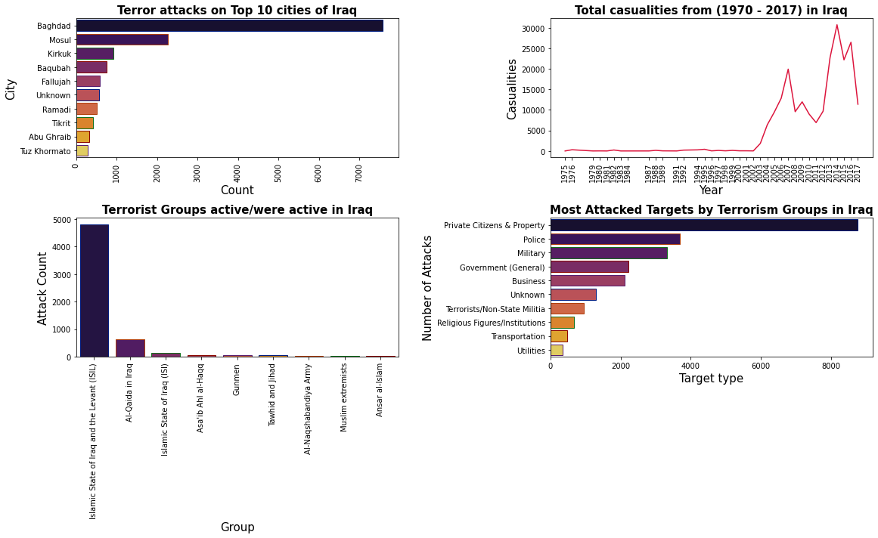
Country wise analysis
Country Iraq

Slide 16
here we are doing the country wise analysis of terrorist attacks and by using the bar plot we can easily find out the most affected city and most safe city of the country. also most active terrorist organization in the respective country and what are the main targets of terrorist attack by getting exact figures. We can also find out the trends in the casualties from the year 1970 to 2017.
Observation :-
1.Here we did the analysis of most affected country of terrorism Iraq.
2.Most number of attacks happen in the Baghdad city of Iraq
3.Islamic state of Iraq and the levant (ISIL) is the most active terrorist organization in the country which record highest attacks
4.The number of casualties increases per year till 2014 later it is decreases.
5.Main target of terrorist is private Citizens and Property followed by Police, Military, and Government

Slide 17
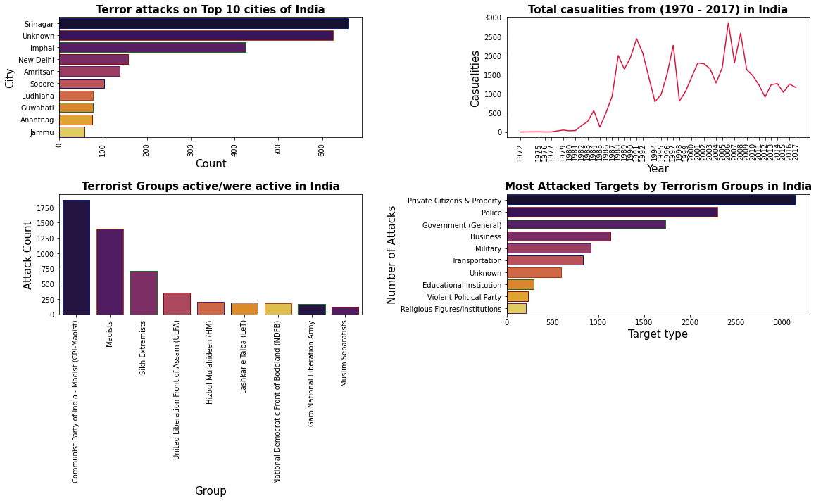
Country India

Slide 18
Observation :-
1.Here we did the analysis of most affected country of terrorism India.
2.Most number of attacks happen in the Shrinagar city of India.
3.Communist party of India - Maoist(cpi-Maoist) is the most active terrorist organization in the country which record highest attacks.
4.The number of casualties varies per year from 1985 to 2014.
5.Main target of terrorist is private Citizens and Property followed by Police, Government and Business.

Slide 19
Challenges Faced -:
Reading the dataset and comprehending the problem statement.
Examining the business KPIs for app development and devising a solution to the problem.
Handling the error and NaN values in the dataset.
Designing multiple visualizations to summarize the information in the dataset and successfully communicate the results and trends to the reader.

Slide 20
Conclusion’s
It was clear that numbers of terrorist attacks were increases from 2002-2004. Most of the attacks were done on year 2014 and Iraq is the most affected country from terrorism because most of the peoples killed in Iraq. In Iraq maximum of 1570 peoples killed in single attack. As expected Baghdad is most affected city(and yes this is also called province).
Among all the regions "Middle East & North Africa" has the most number of killed people Approx 1.4 Lakhs followed by "South-Asia" & "Sub-Saharan Africa
"Taliban" is the most powerful, dangerous and the most active gang among all the gangs, followed by “Islamic state of Iraq and the levant(ISIL)" and "shining path(SL)".
The most targeted attacks are on "Private Citizens & Property" which is approximately 40% and 10-20% is the target on "Military", "Police", "Government", "Business".
"It seen that explosives were used in around 51.09% of the attacks, followed by Firearms accounted for 32.35% of the attacks".

Slide 21


